Slide 3
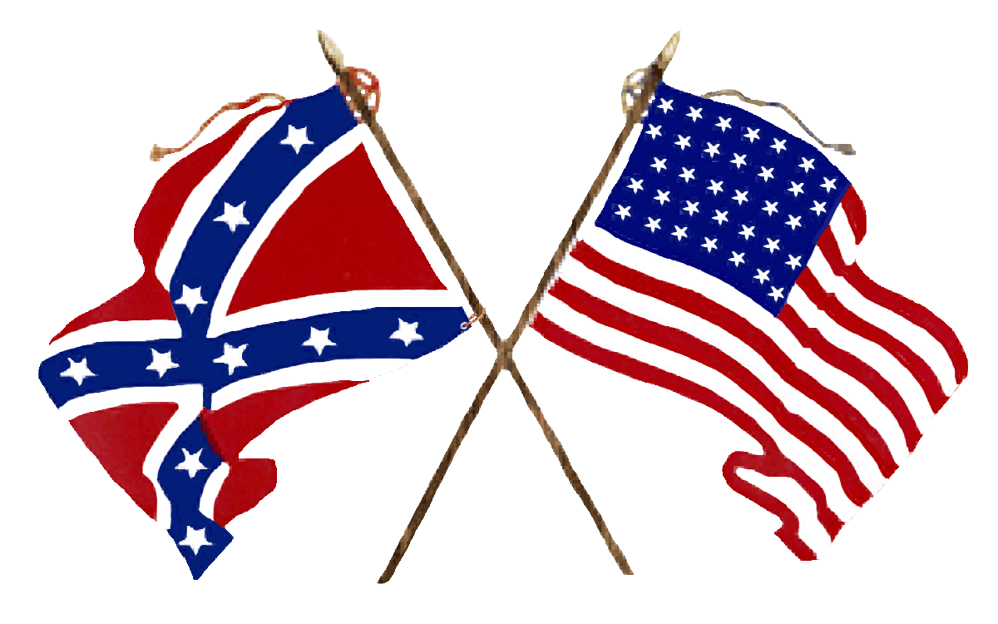
American Civil War battle naming conventions
Battle names have caused controversy since 1861. The Union Army frequently named battles after significant rivers and creeks that played a role in the fighting; the Confederates generally used the names of nearby towns or farms.
Date | Confederate | Federal (Union)
July 21, 1861 | First Manassas | First Bull Run
Aug. 10, 1861 | Oak Hills | Wilson's Creek
Mar. 7-8, 1862 | Elkhorn Tavern | Pea Ridge
Apr. 6-7, 1862 | Shiloh | Pittsburg Landing
June 27, 1862 | Gaines's Mill | Chickahominy
Au 29-30, ‘62 | Second Manassas | Second Bull Run
Sept. 17, 1862 | Sharpsburg | Antietam
Even today, the US National Park Service uses the Confederate name for the national battlefield park, but the Union name (Bull Run) also has widespread currency in popular literature.

Slide 4
Western (upper) vs Eastern Theatres

Slide 5
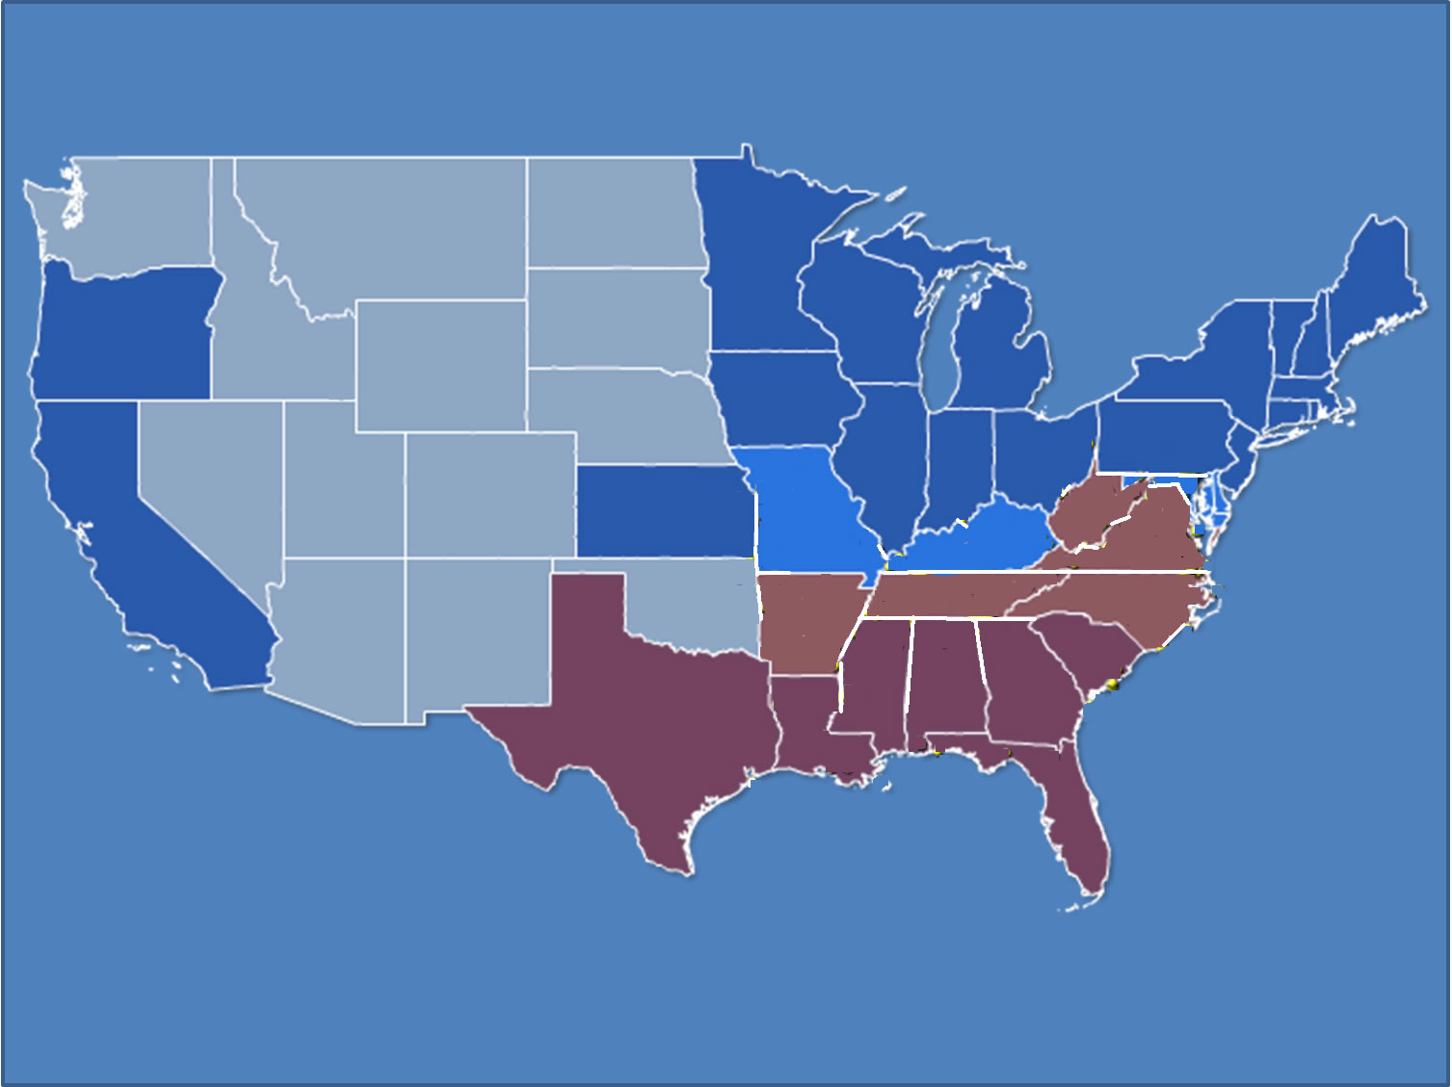
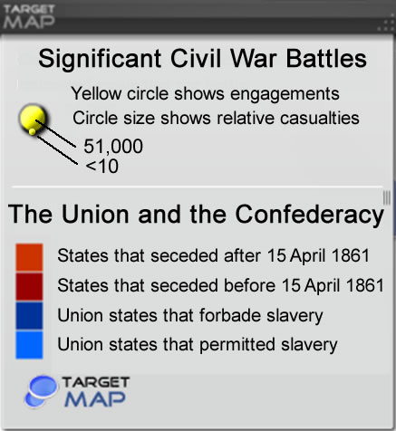
Location of Significant Civil War Battles
Western
Theater
Eastern
Theater
Manassas
21/7/61
Fort Sumter 26/12/1860- 12/4/1861
Trans-Mississippi
Theater
Western
Theater

Slide 6
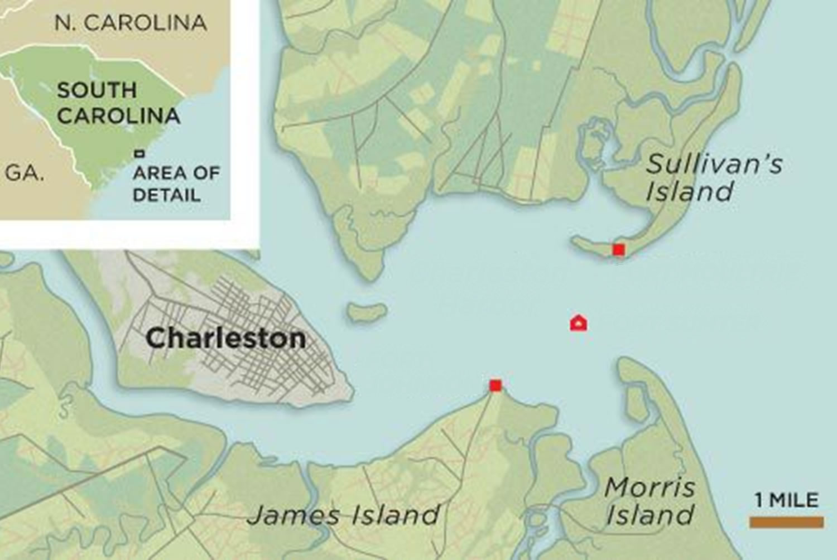
Charleston
Harbor
Fort Sumter

Slide 7
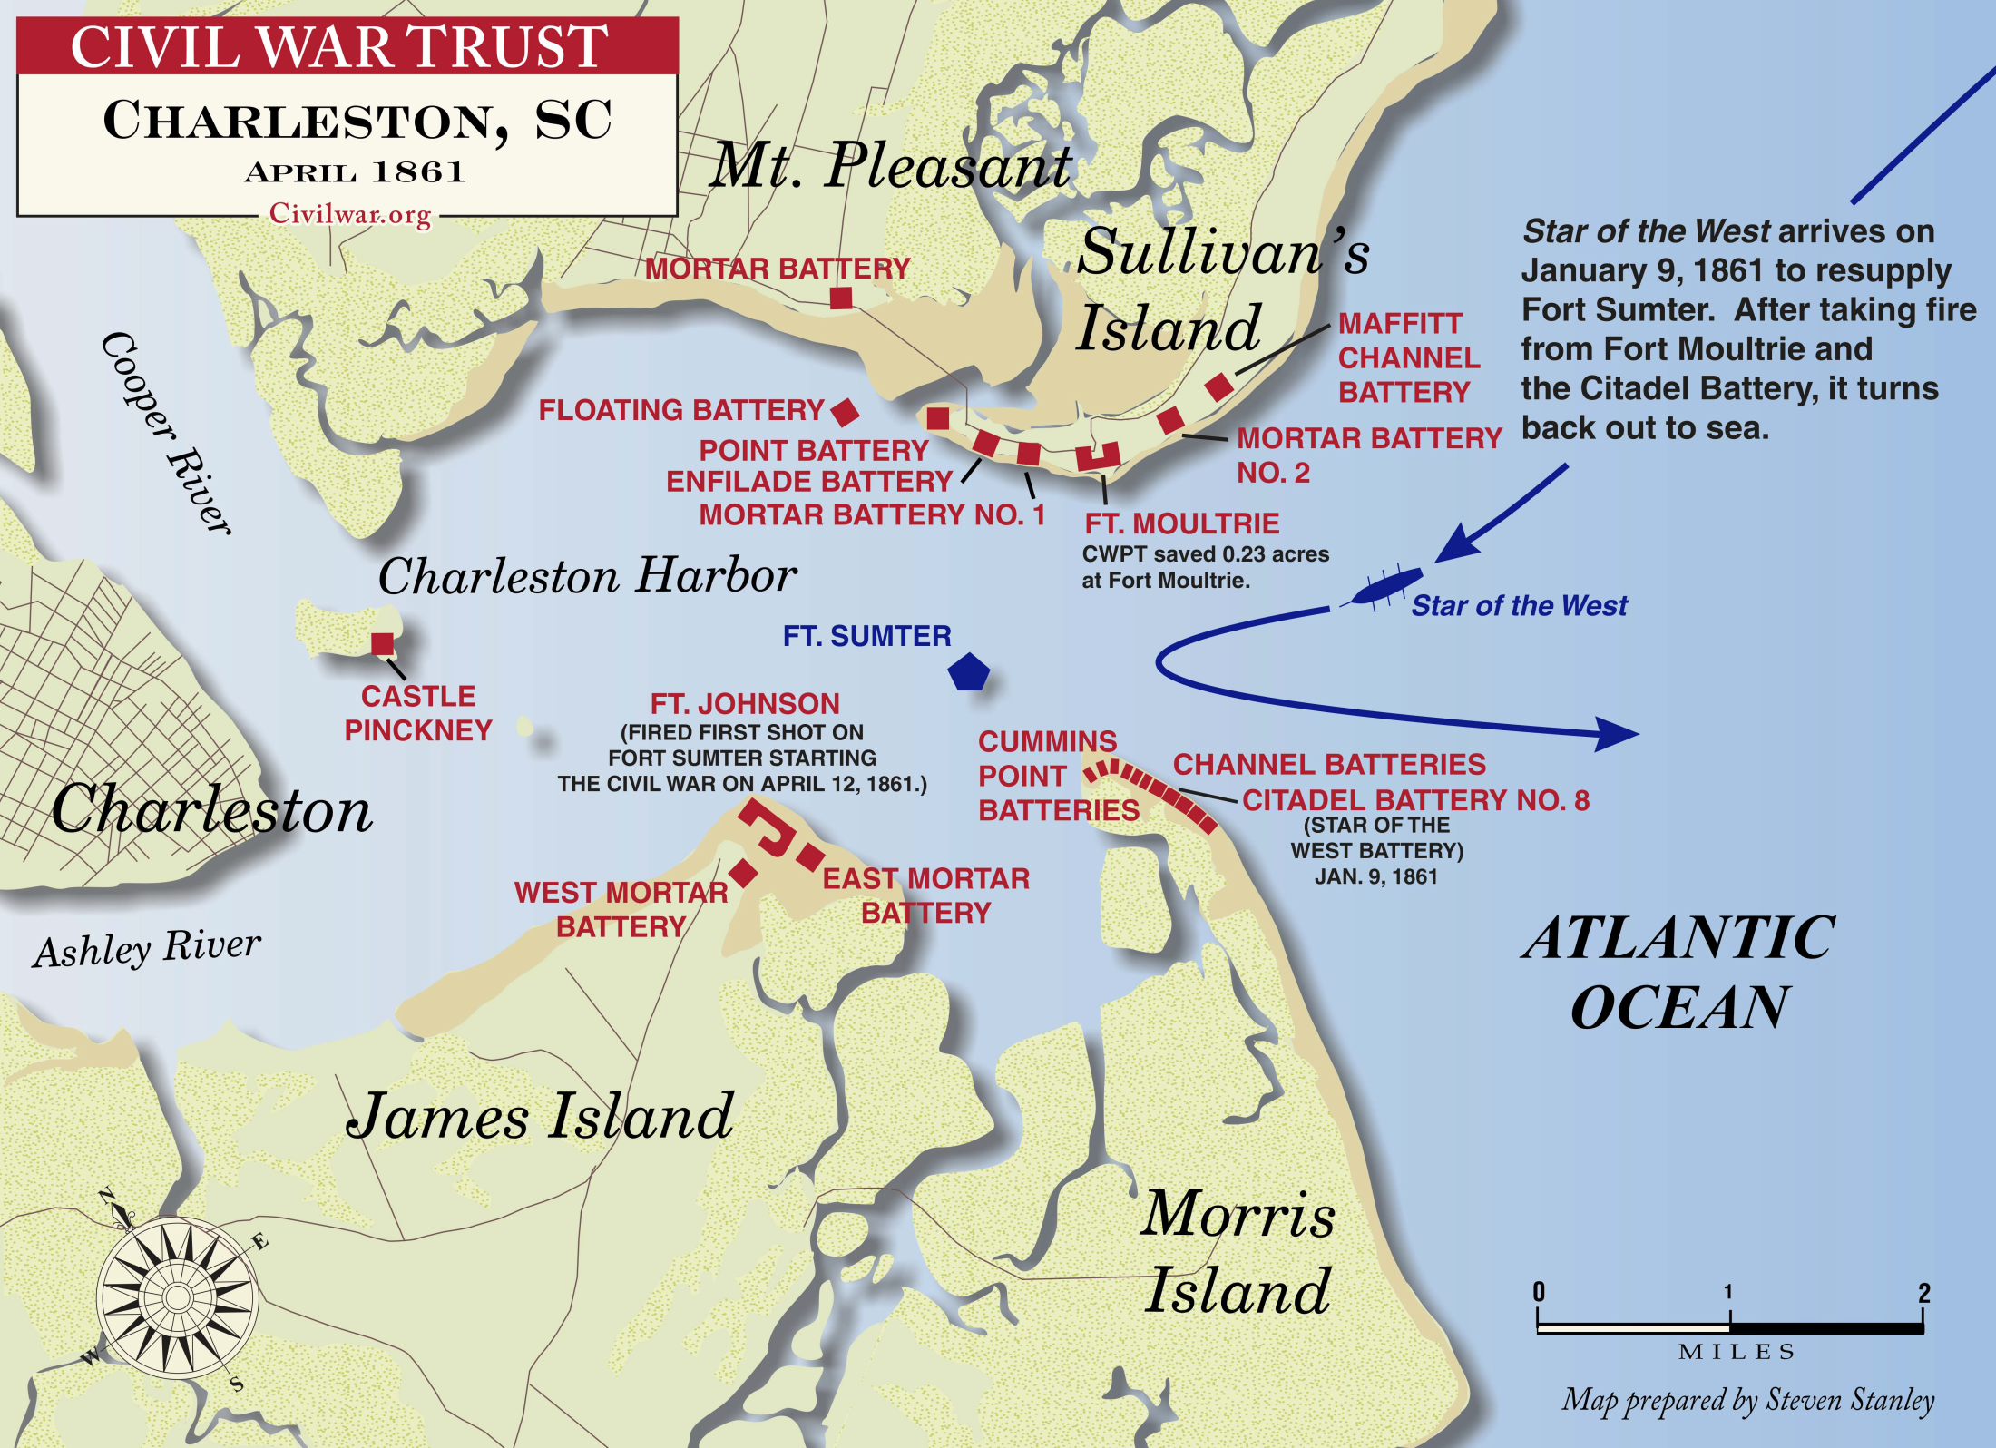

Slide 8
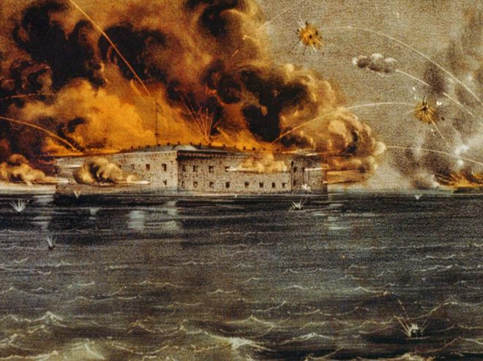

Slide 9
Plus isolated combat until 2 June 1865

Slide 12
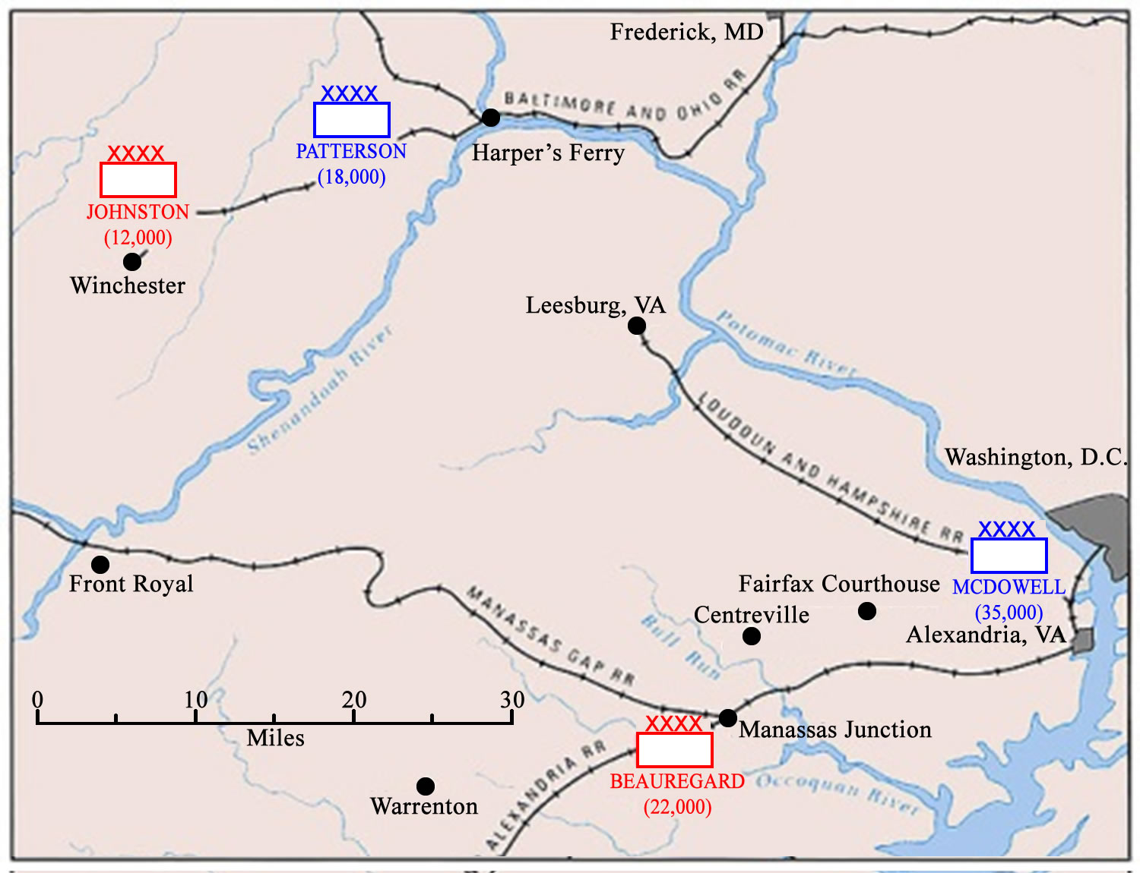
ORDER OF BATTLE
June-mid July 1861
Union
Confederate
SHENANDOAH VALLEY
BLUE RIDGE MOUNTAINS

Slide 13
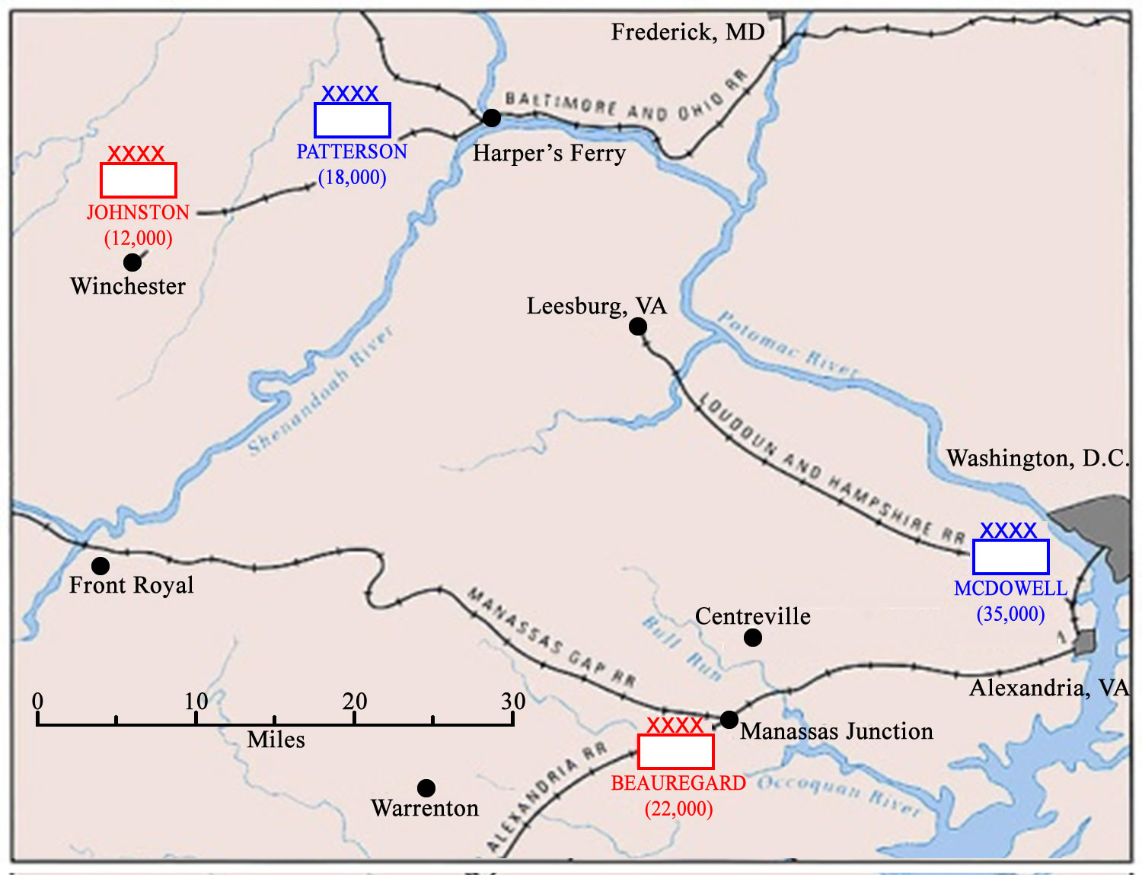
Hoke’s Run
2 July
2/7
INITIAL CONTACTS
Fairfax Court House 8/8
Arlington Mills 2/1
Vienna, VA 12/?
Hoke’s Run 23/91
Blackburn’s Ford 83/68
SHENANDOAH VALLEY
BLUE RIDGE MOUNTAINS
17/6
1/6
1/6
18/7

Slide 14
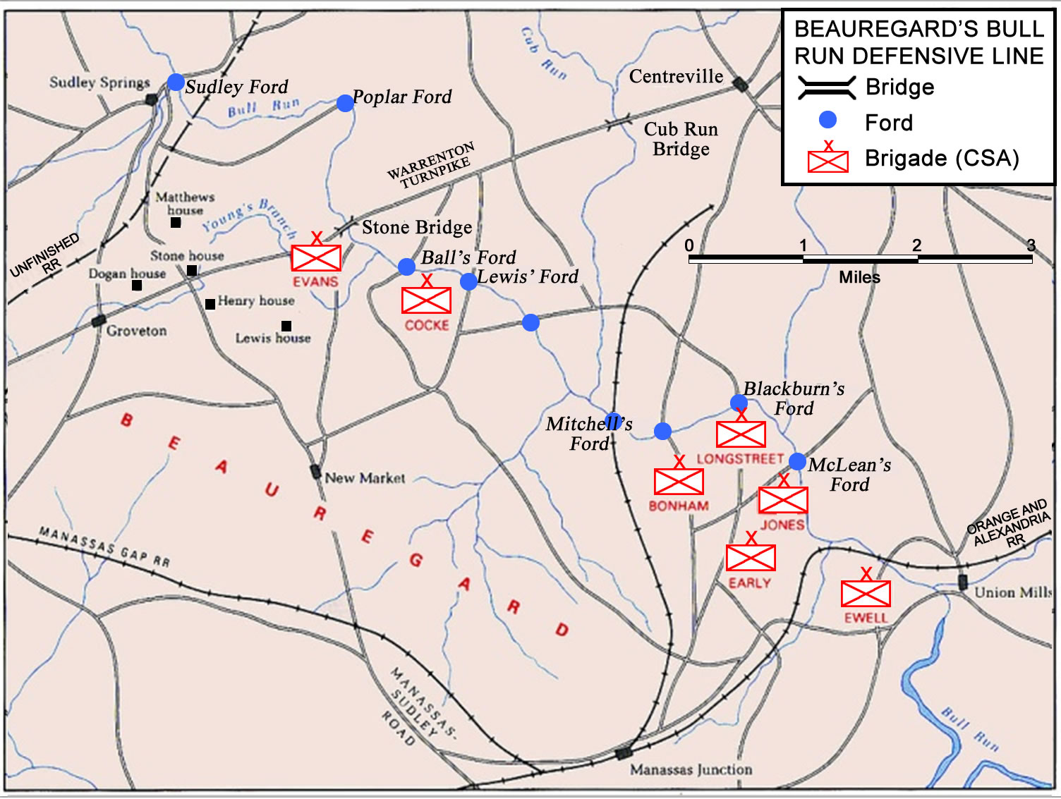

Slide 15
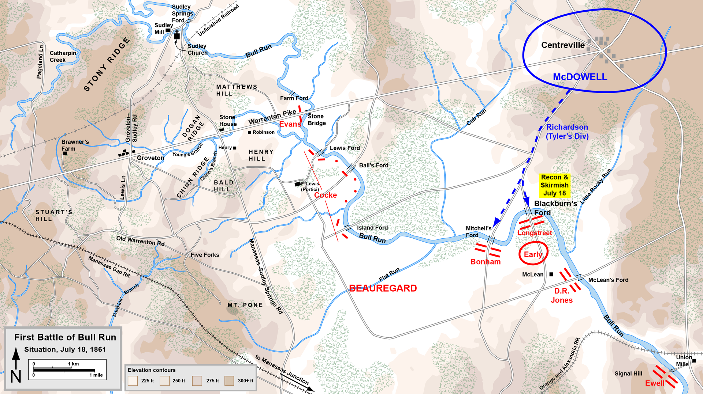
Battle at Blackburn’ Ford, 18 July

Slide 17
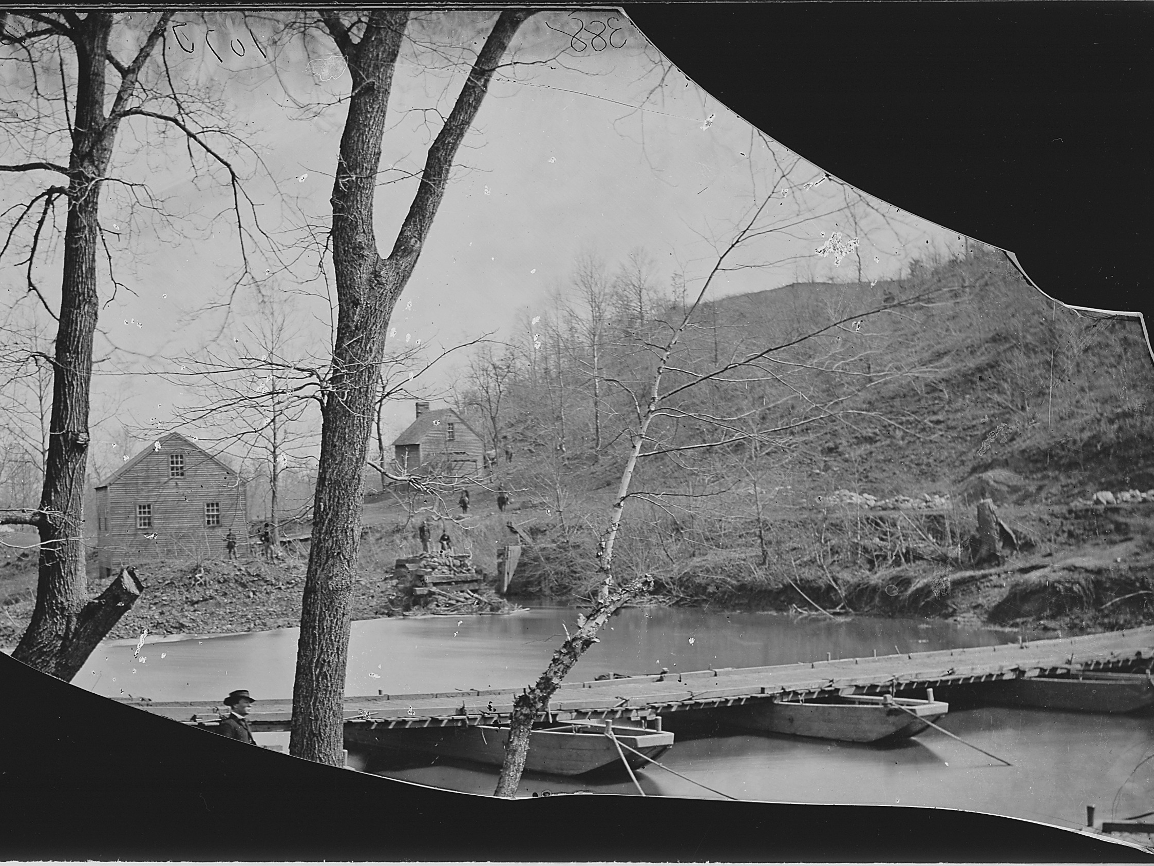
Postnote
Per both Longstreet and Early, the battle "went a long way towards winning the victory of the 21st, for it gave our troops confidence in themselves".

Slide 18
Reactions to Blackburn’s Ford
McDowell believed Rebel right flank secured.
Spent two days scouting Rebel left flank.
Came up with classic attack relying on speed and surprise.
Beauregard called upon Johnston for help.
COL JEB Stuart’s cavalry screened; Johnston’s brigades save 1 left via rail. Arriving by 0730 on 19 July. Arty and Cav came by road.
Two more brigades came by from Richmond.

Slide 19
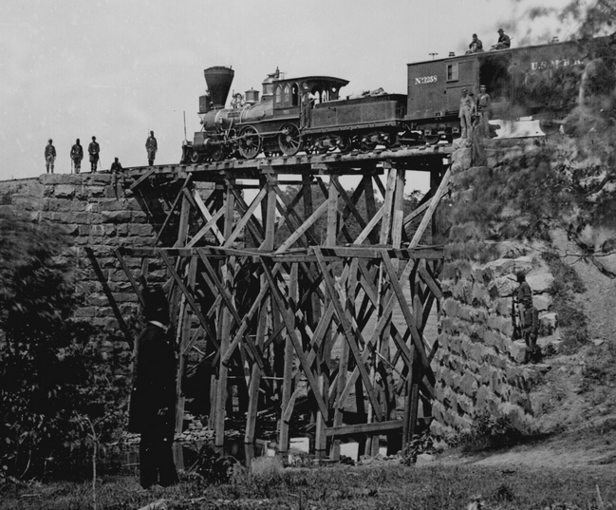

Slide 20
Union Order of Battle
XXXX
Army of N.E. Virginia BG Irvin McDowell
XX
XX
XX
XX
XX
1st Division
BG Tyler
2nd Division
COL Hunter
3rd Division
COL Heintzelman
4th Division
BG Runyon
5th Division
COL Miles
w
w
X
X
X
X
X
1st Brigade
COL Keyes
1st Brigade
COL Porter
1st Brigade
COL Franklin
Militia
1,2,3,4 NJ
1st Brigade
COL Blenker
X
X
X
X
X
2nd Brigade
BG Schenck
2nd Brigade
COL Burnside
2nd Brigade
COL Willcox
w
Volunteers
1,2,3 NJ, 41 NY
2nd Brigade
COL Davies
X
X
3rd Brigade
COL Sherman
3rd Brigade
COL Howard
X
4th Brigade
COL Richardson

Slide 21
Confederate Order of Battle
XXXX
XXXX
30th VA Cavalry
(COL Radford)
among bde’s
Army of the Potomac BG PGT Beauregard
Army of the Shenandoah GEN Joseph E. Johnston
X
X
X
X
X
1st Brigade
BG Bonham
2nd Brigade
BG Ewell
3rd Brigade
BG Jones
1st Brigade
BG Jackson
2nd Brigade
COL Bartow
w
K
X
X
X
X
X
4th Brigade
BG Longstreet
5th Brigade
COL Cocke
6th Brigade
COL Early
3rd Brigade
BG Bee
K
4th Brigade
BG Smith
w
X
X
II
III
II
7th Brigade
COL Evans
Res Brigade
BG Holmes
Artillery 39 guns
1st VA Cavalry
COL JEB Stuart
Artillery
20 guns

Slide 23
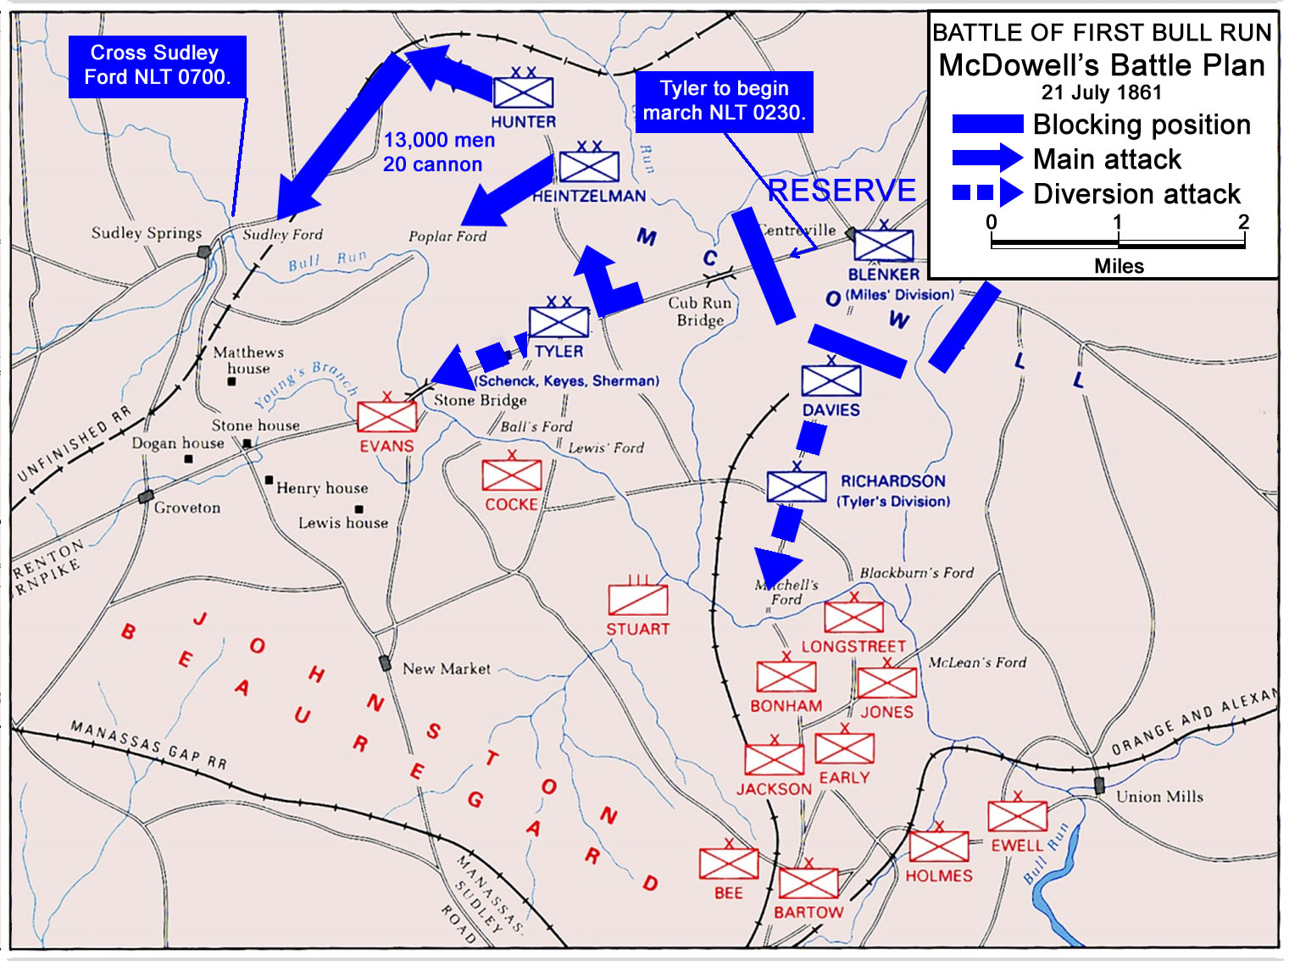

Slide 24
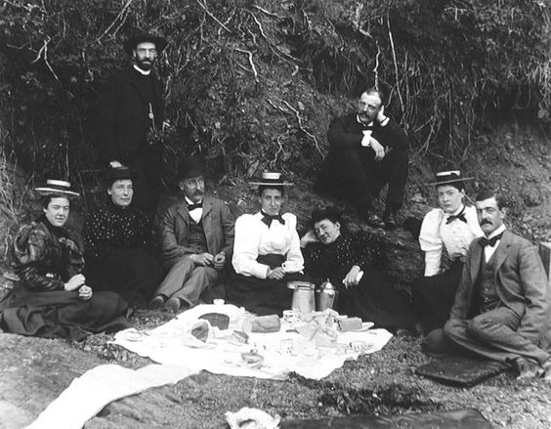

Slide 25
3rd division misses turnoff.
2nd Div elements arrived 0930
“Road” turns out to be path.
1st Div diversion begins 0600
Rebel Signals CPT spots Union 0830
Tyler’s engineers clear bridge 0530
Bee & Bartow arrive 1100
Evan’s 1.100 men & 2 cannon were not expected

Slide 26
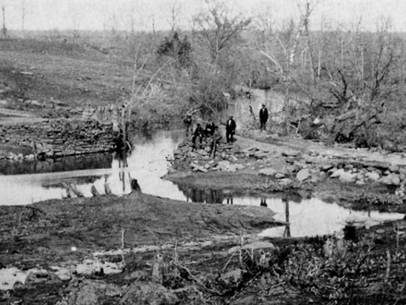

Slide 27
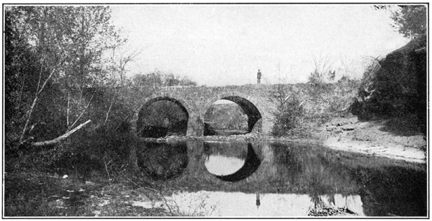

Slide 28
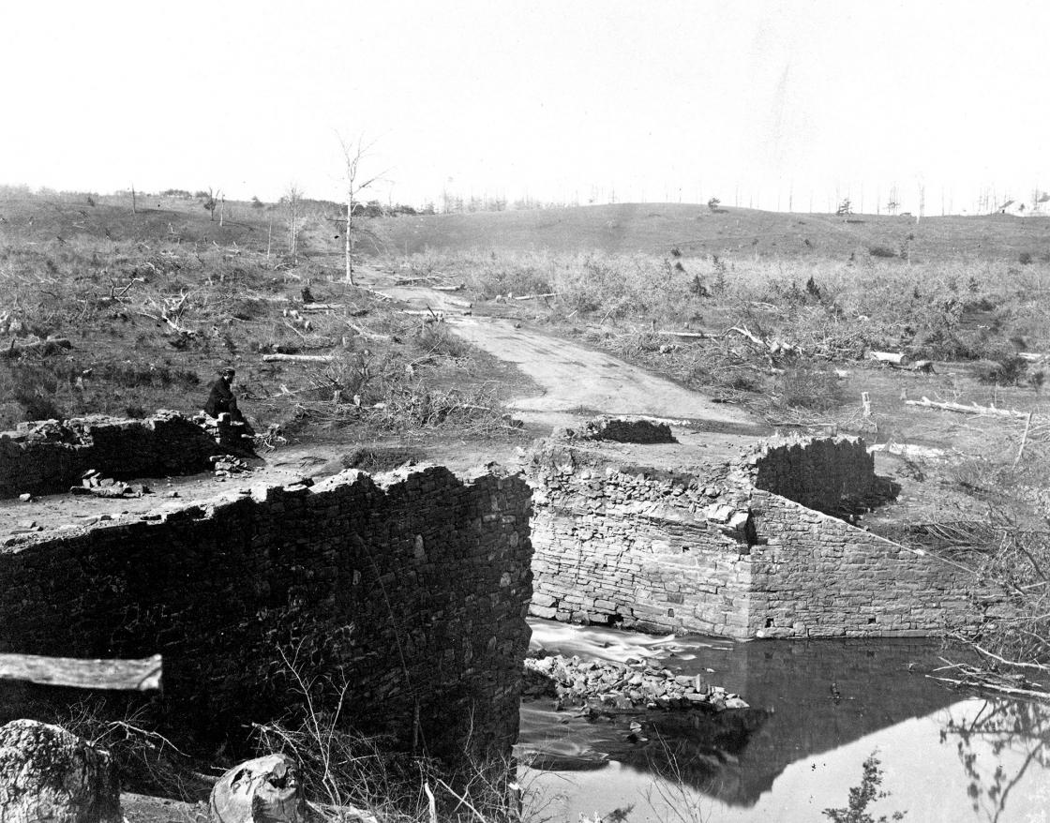

Slide 29
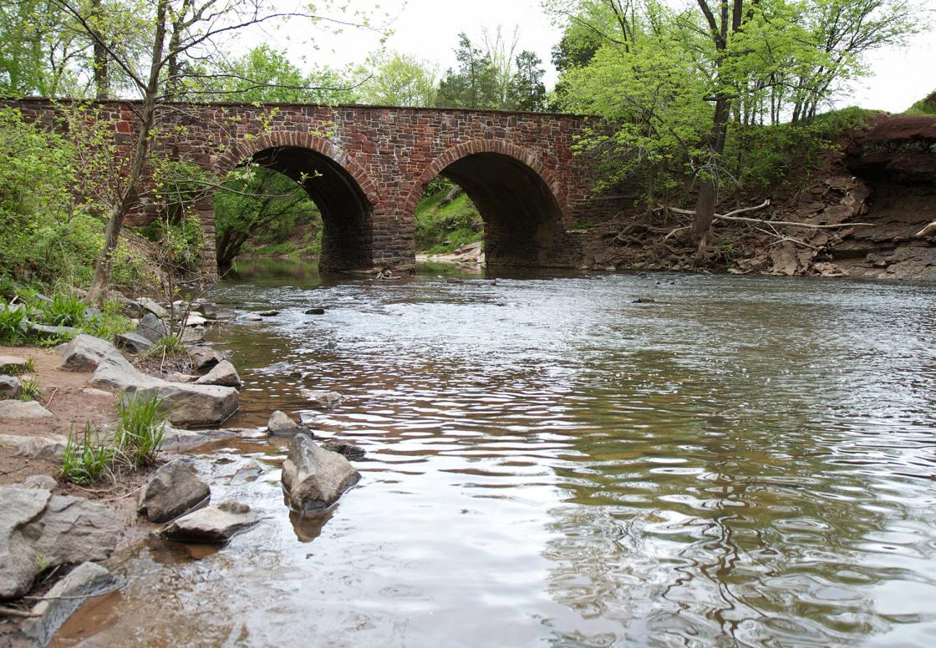

Slide 30
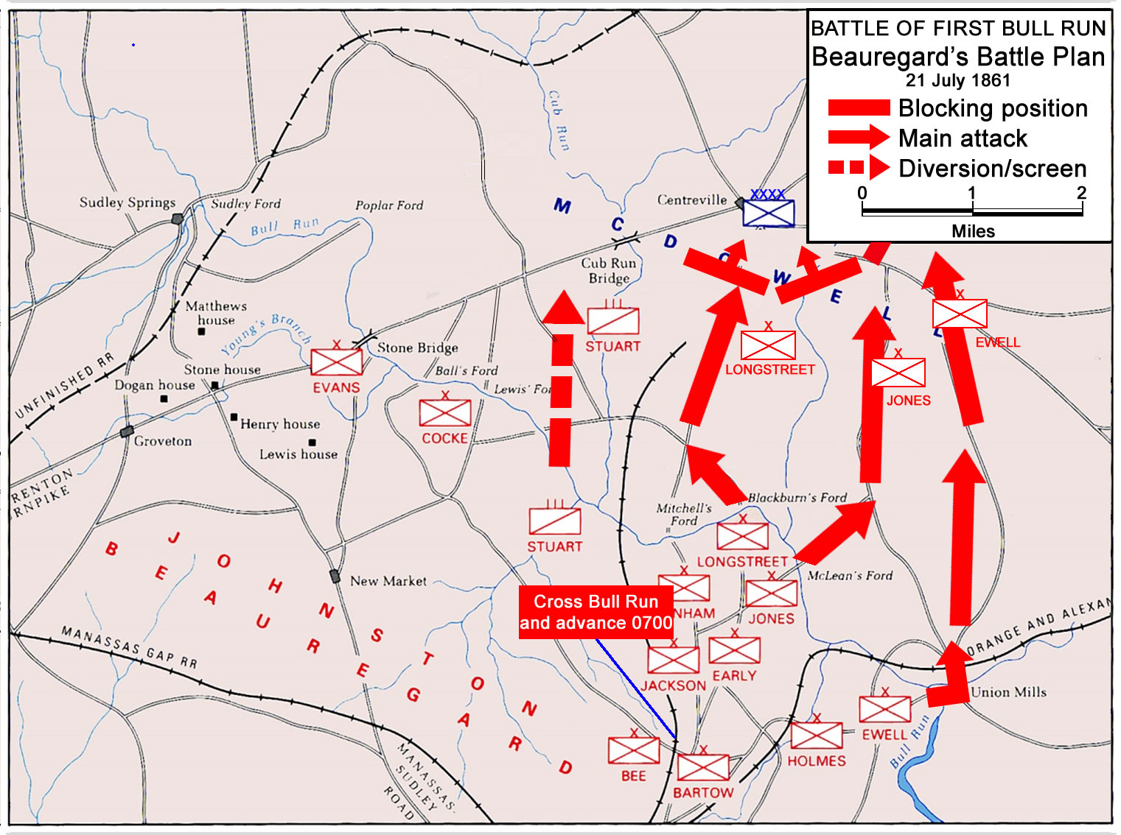

Slide 31
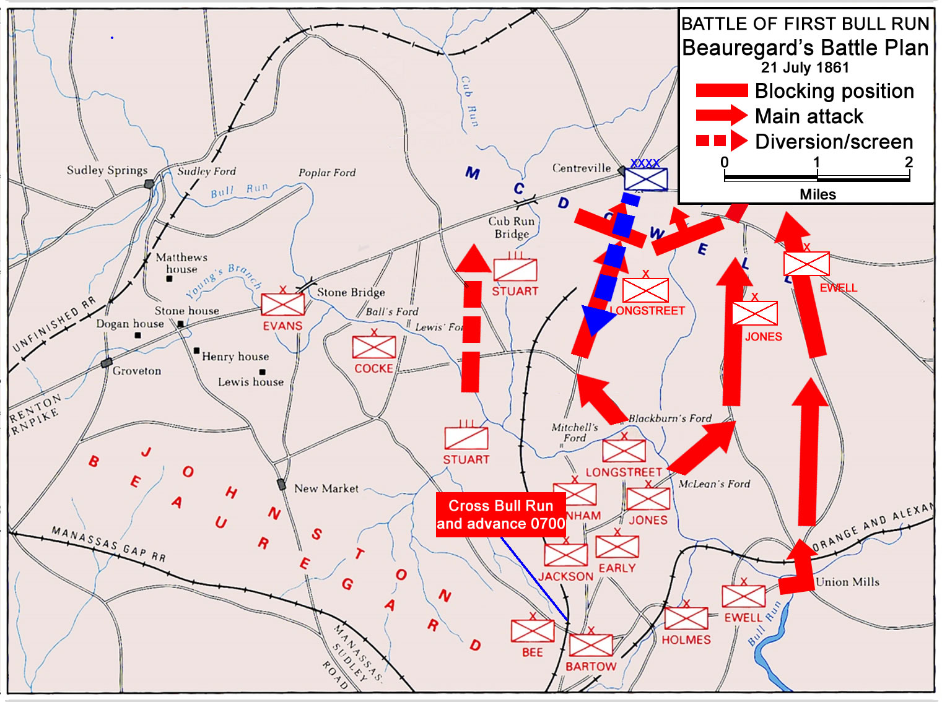
Richardson attack on Mitchell’s Ford
Rebel Signals CPT spots attack 0830
Ewell had not moved by 0800

Slide 32
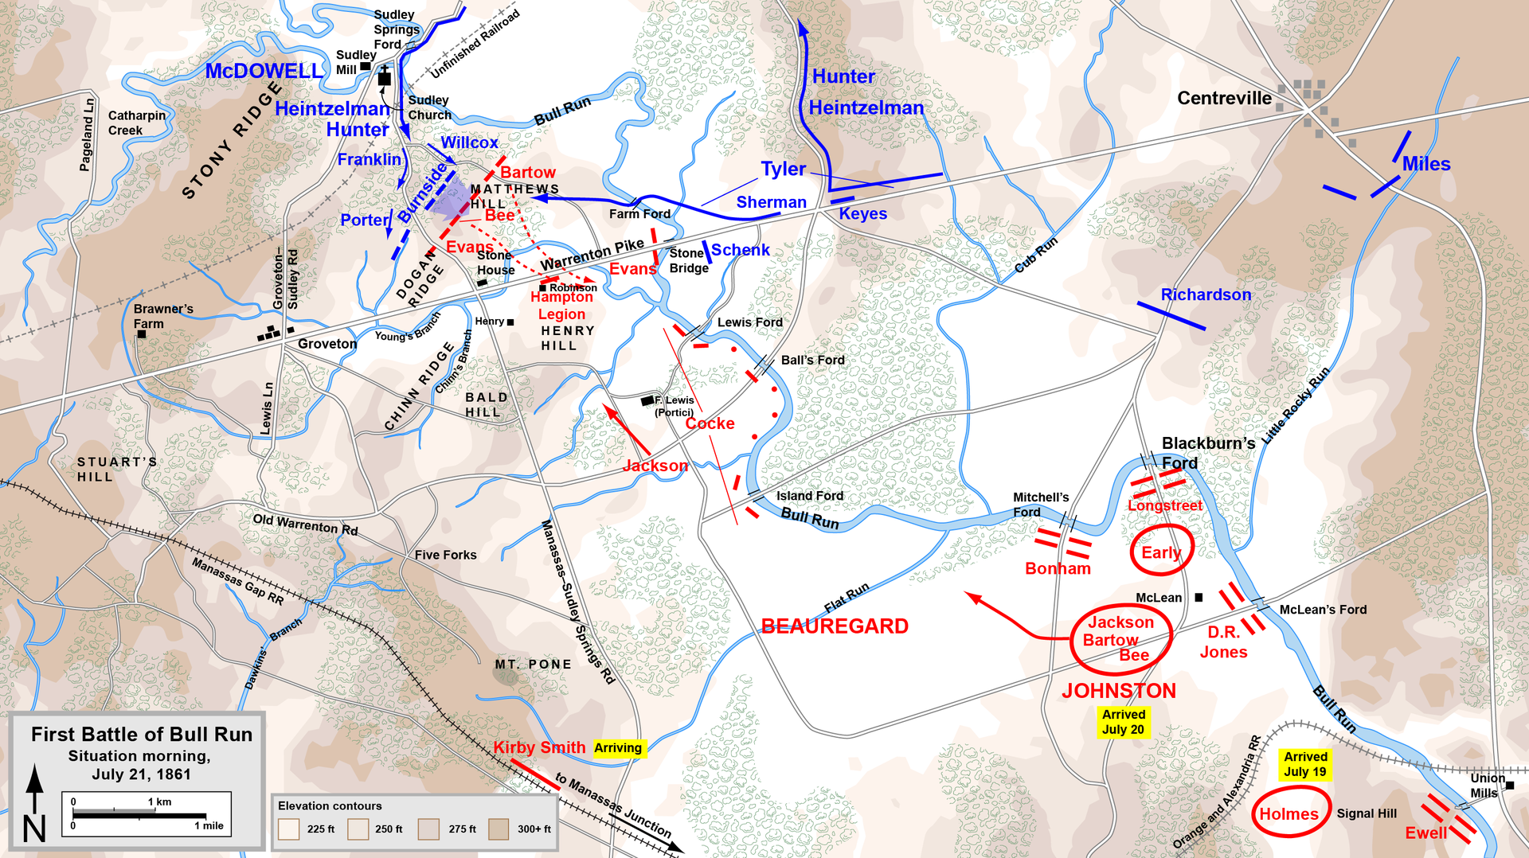

Slide 34
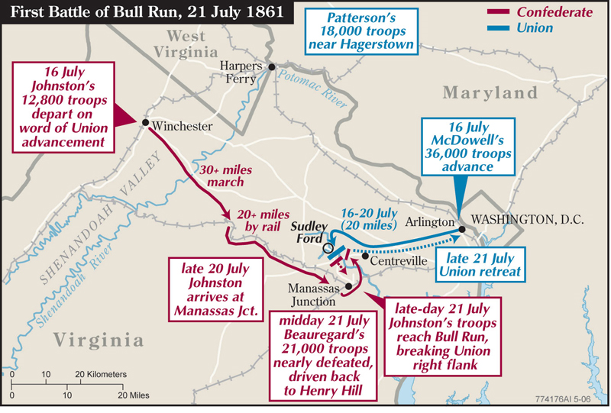

Slide 35
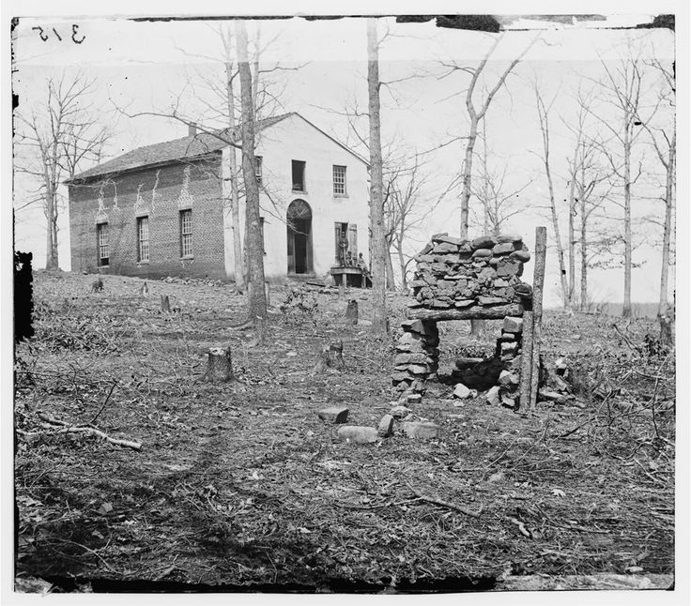

Slide 36
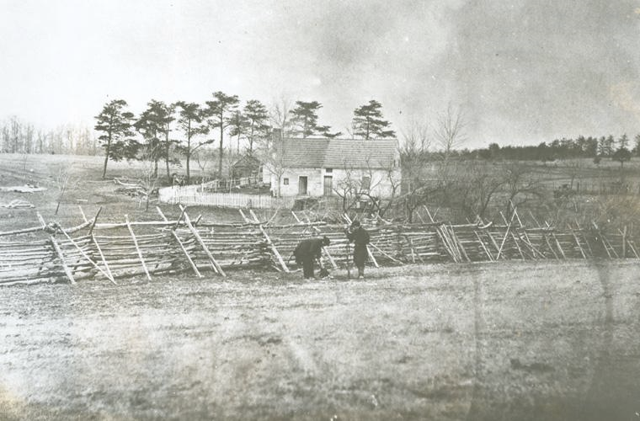

Slide 37
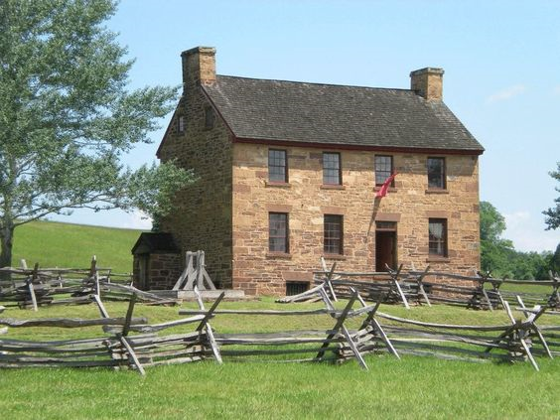

Slide 38
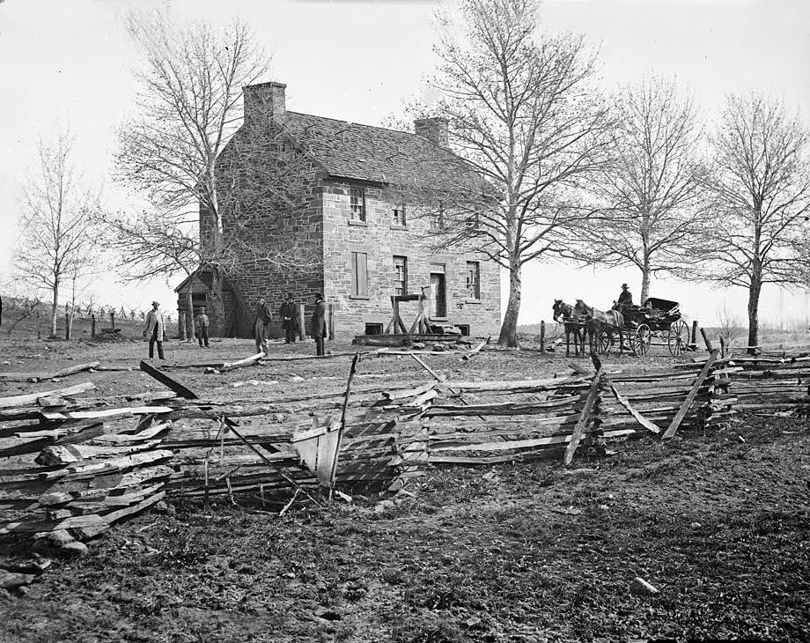

Slide 39
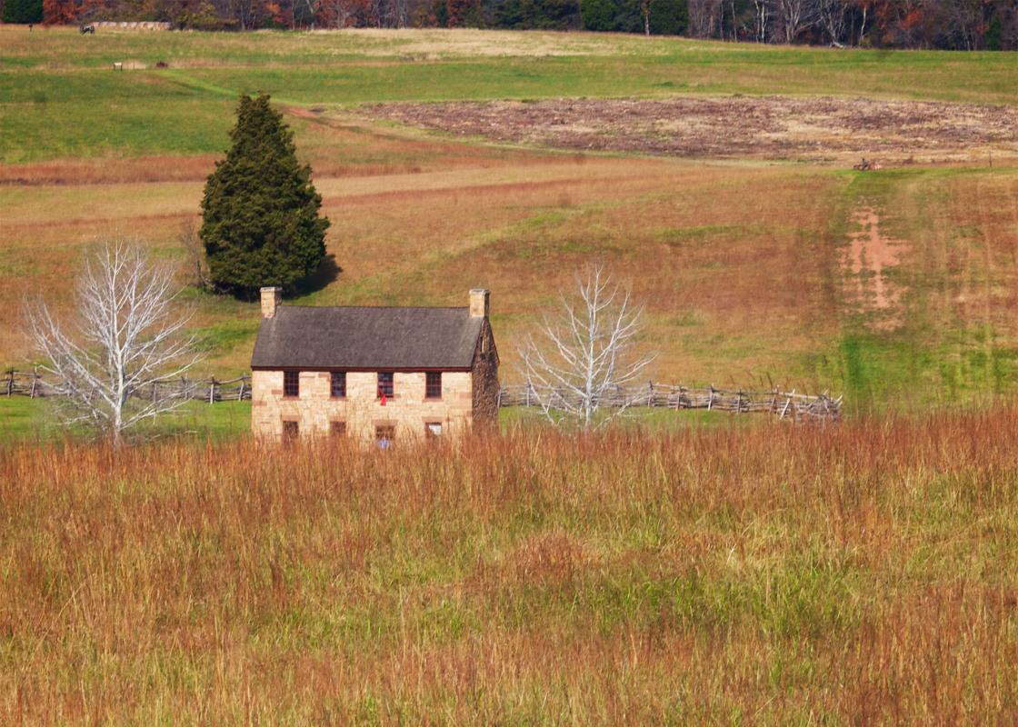

Slide 40
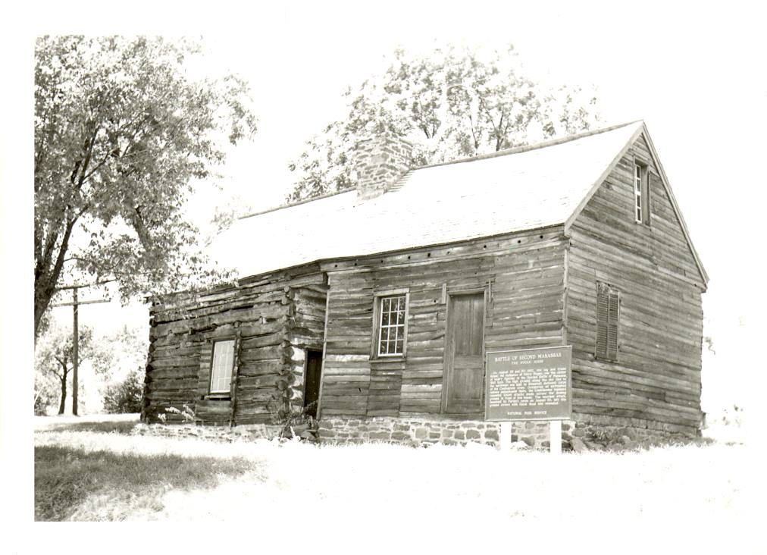

Slide 41
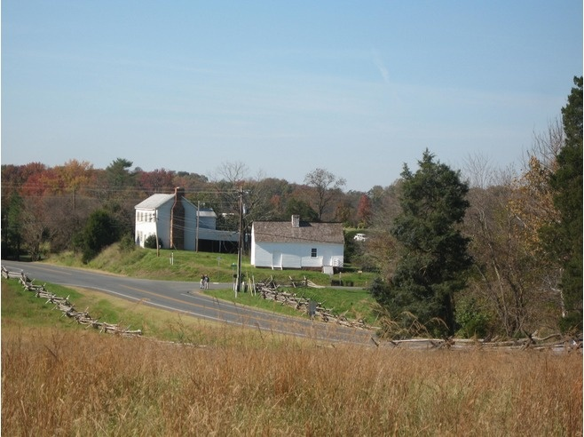

Slide 42
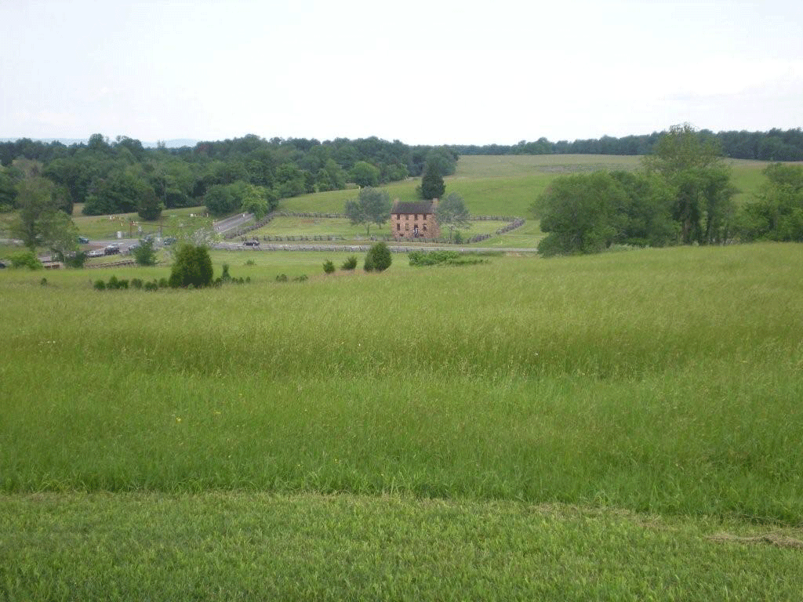

Slide 43
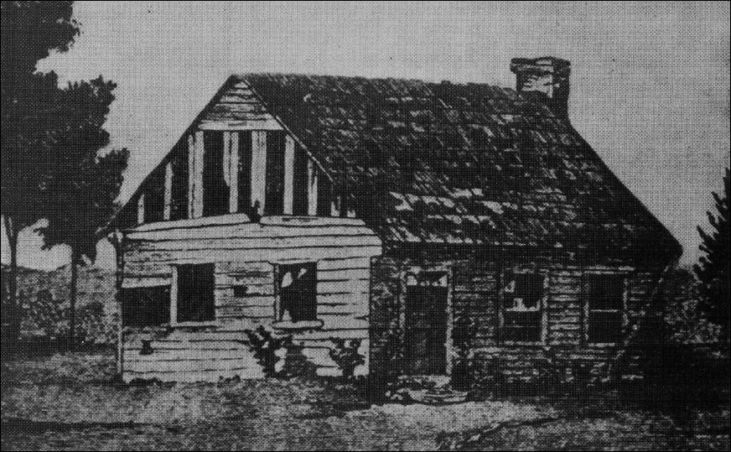

Slide 44
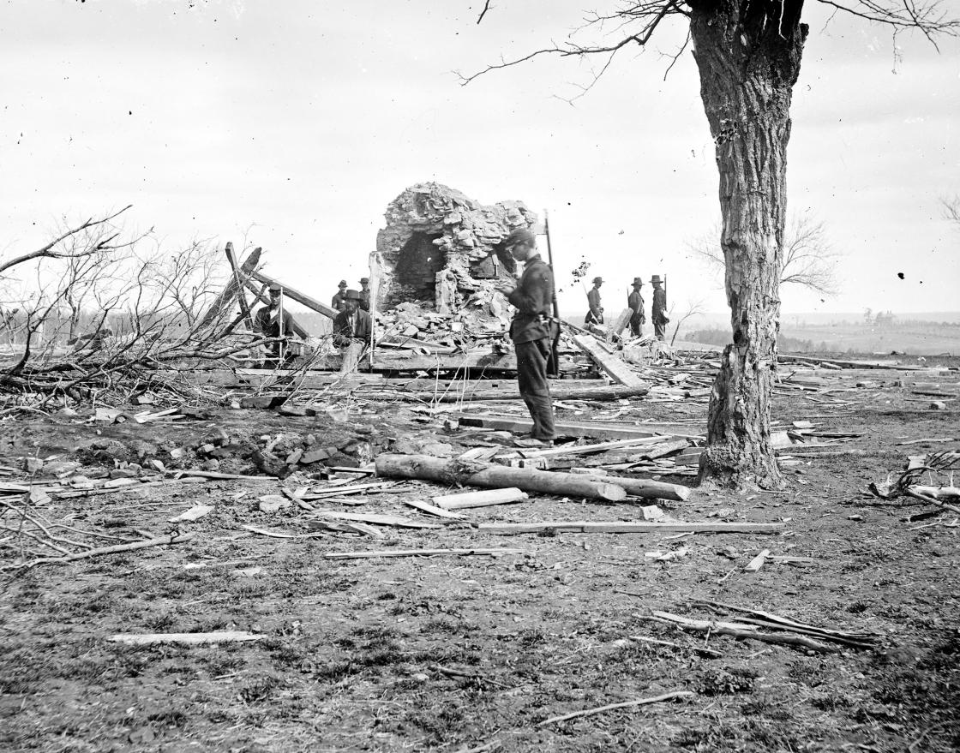

Slide 45
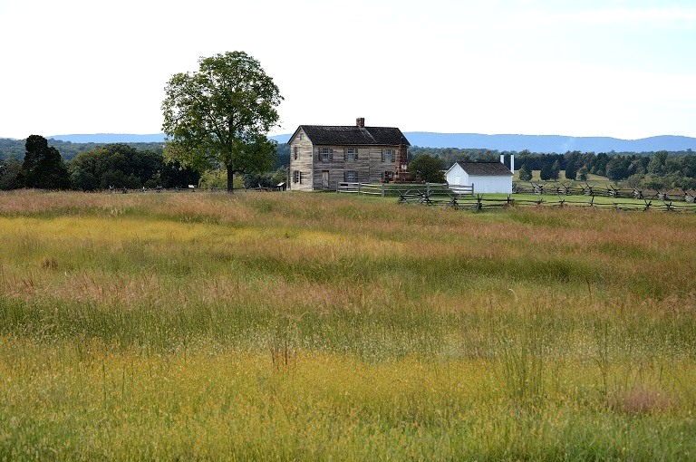

Slide 46
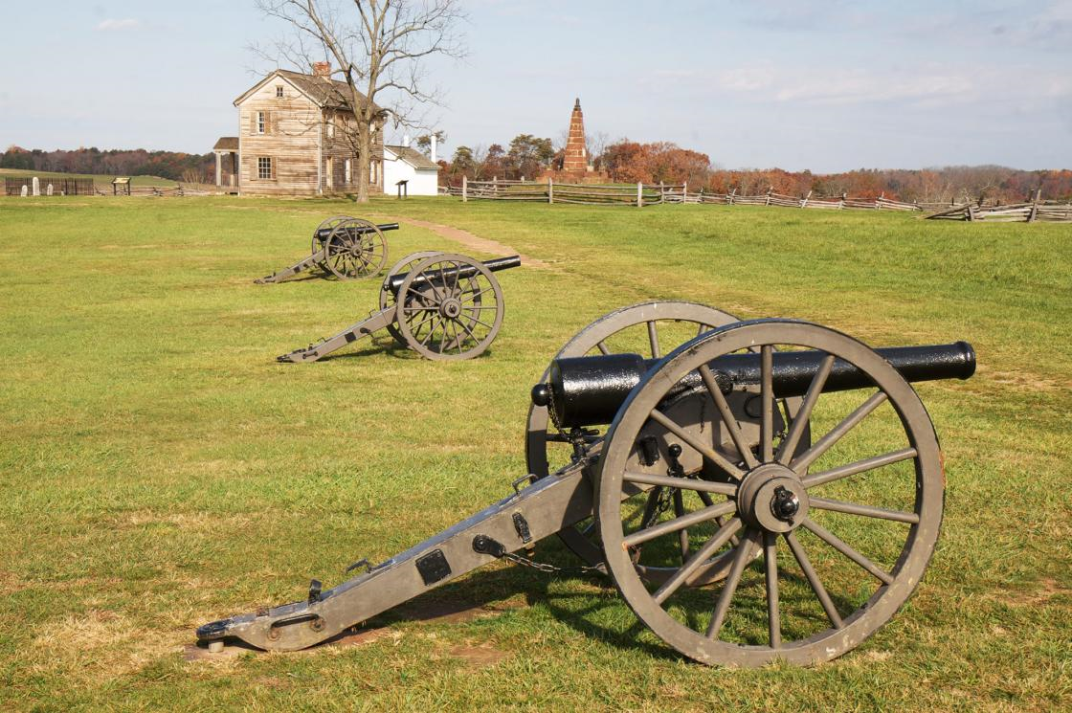

Slide 47
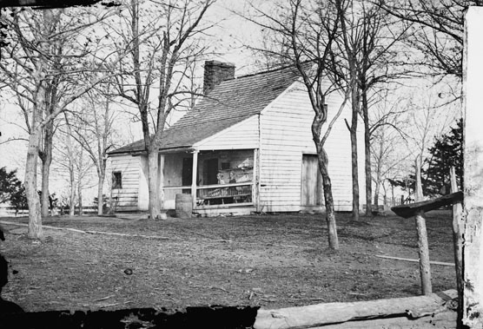

Slide 48
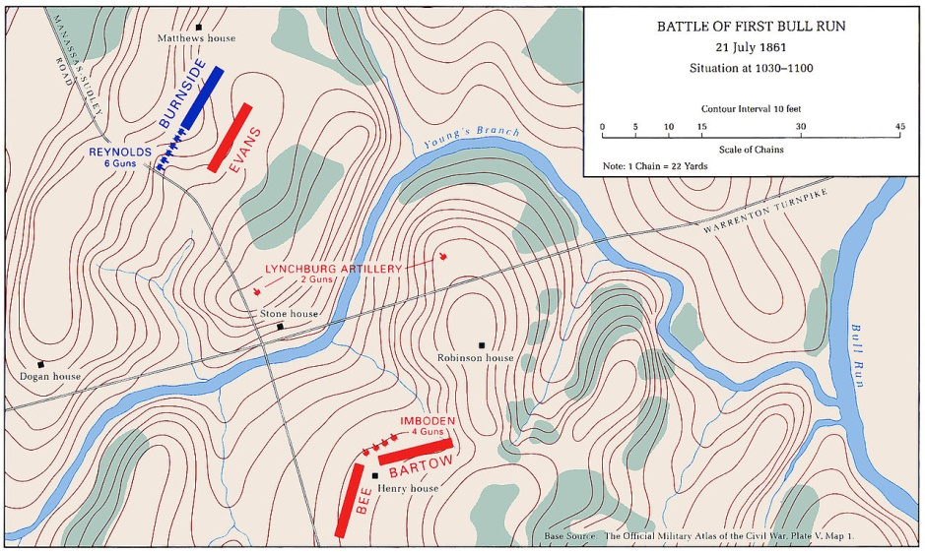

Slide 49
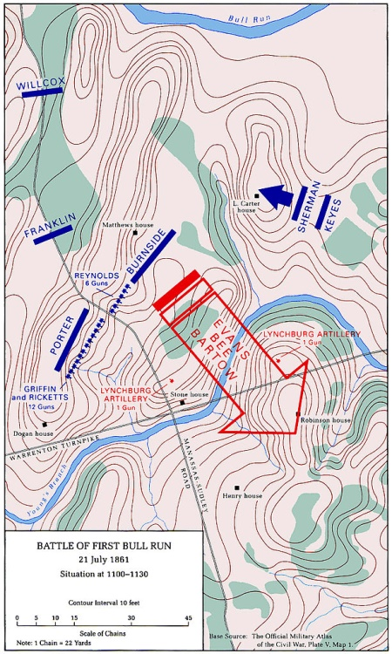
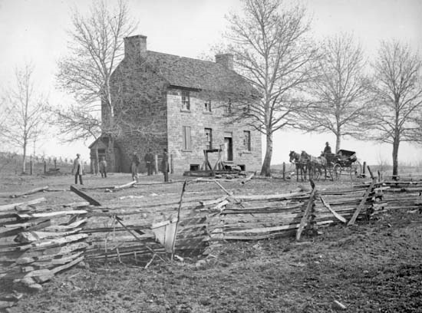

Slide 50
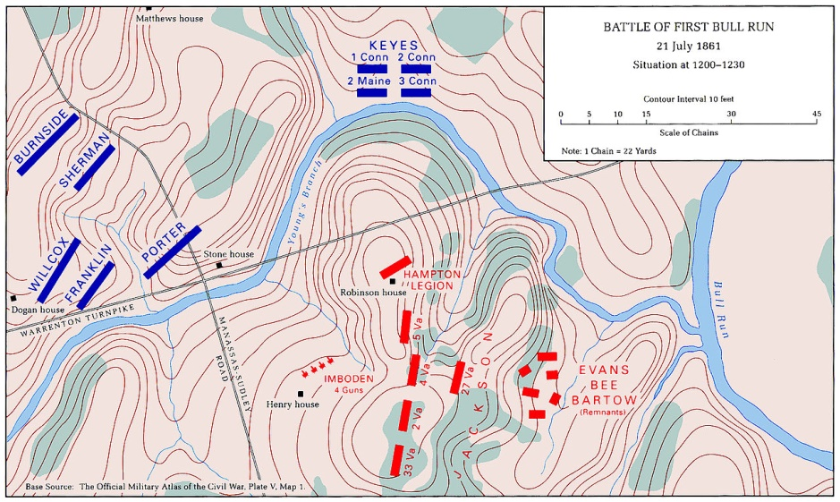

Slide 51
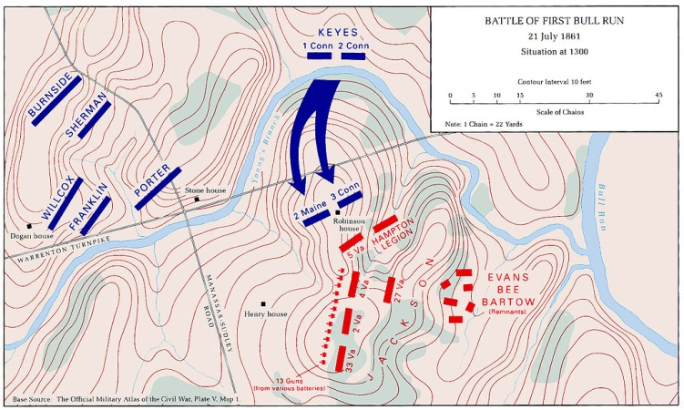

Slide 52
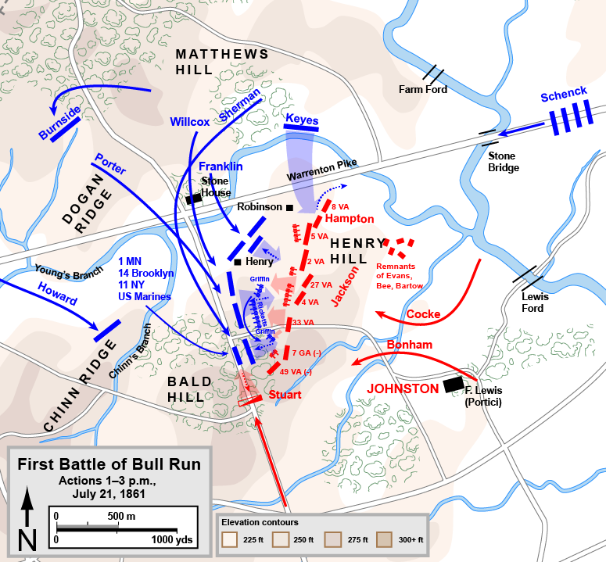

Slide 53
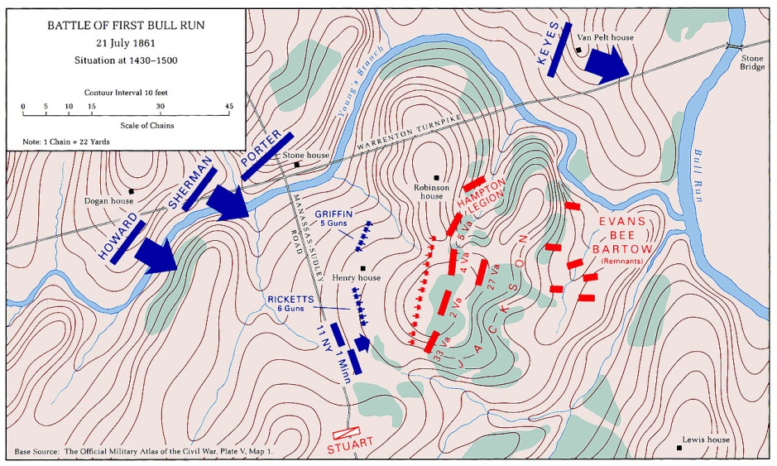

Slide 54
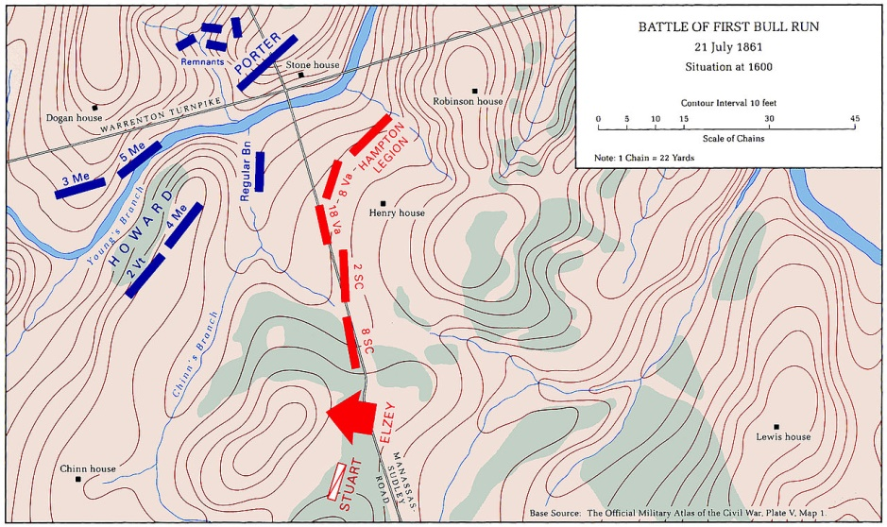

Slide 55
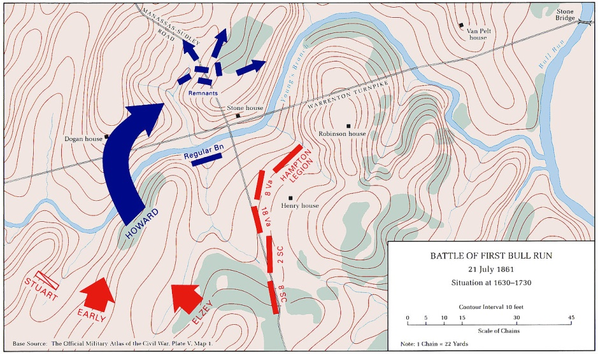

Slide 56
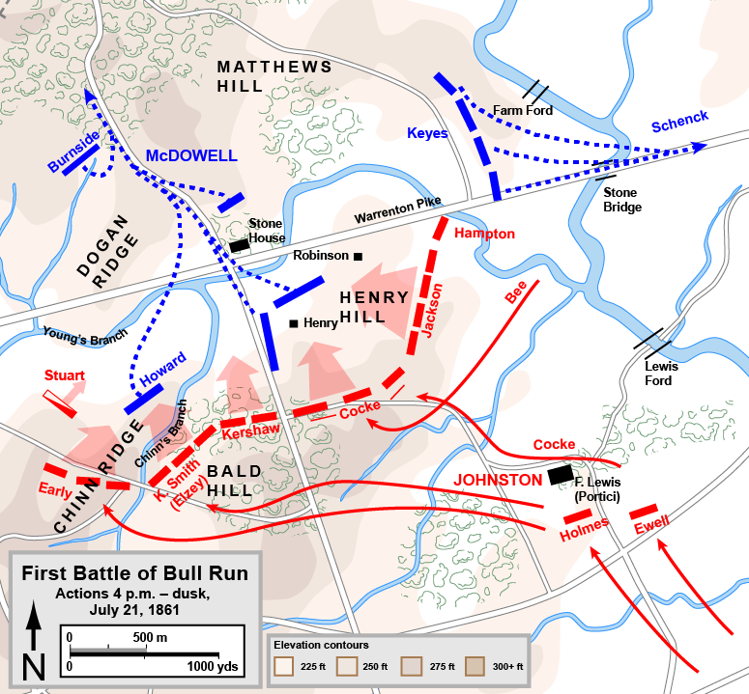

Slide 57
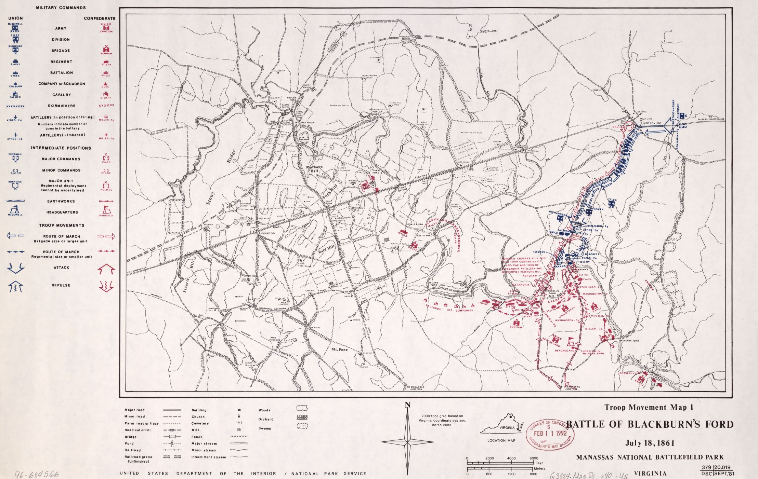

Slide 58
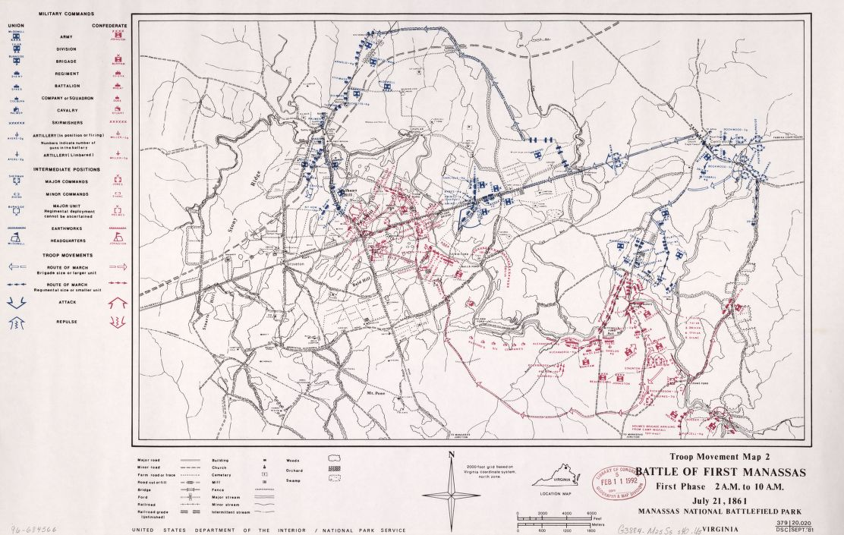

Slide 59
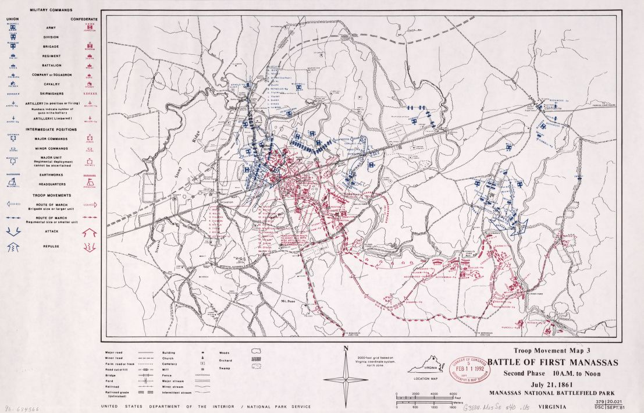

Slide 60
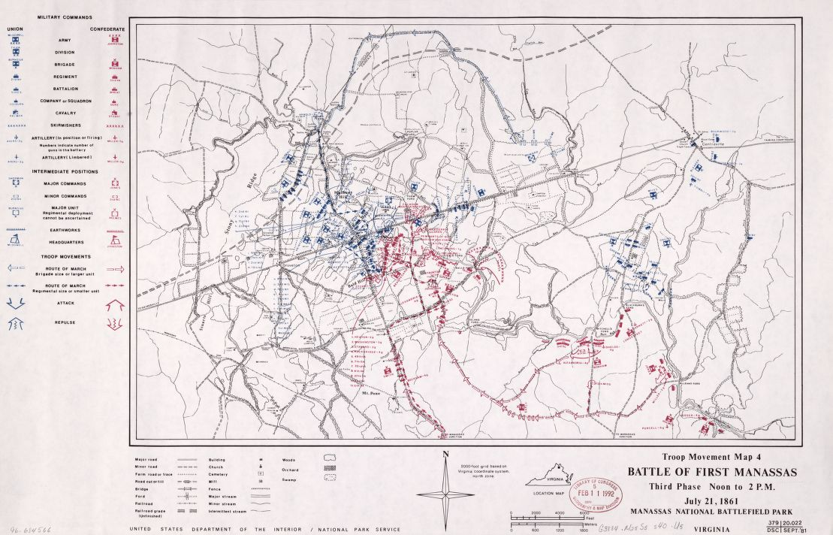

Slide 61
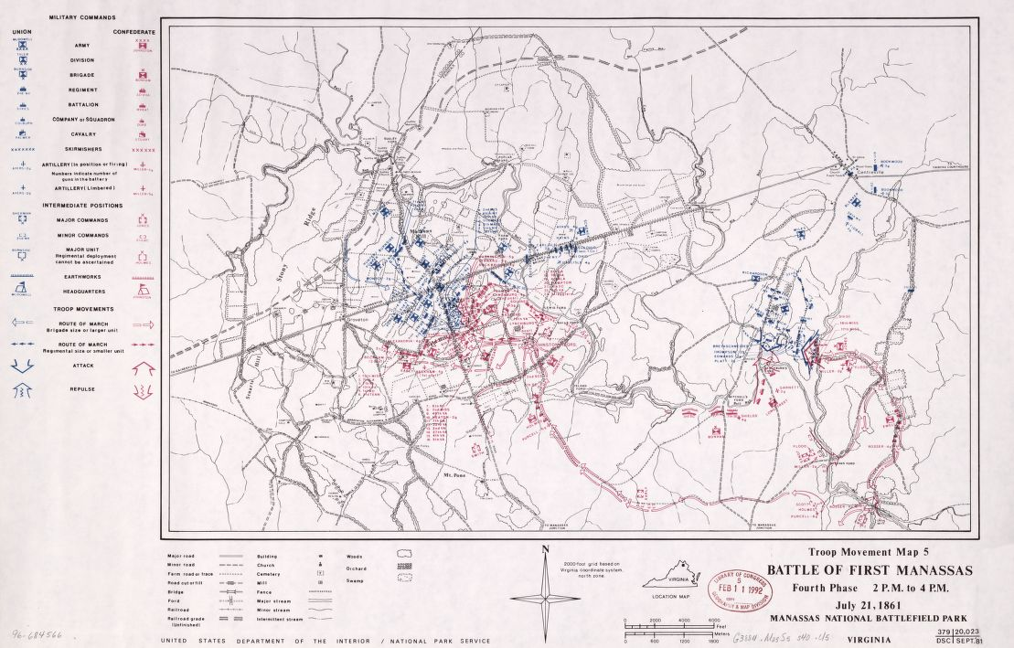

Slide 64
Observations
Neither army was prepared at this stage of the war, but political considerations caused the Federal government to order General Irvin McDowell to advance move against Richmond, Virginia before he or the army were ready.
The 22,000 Confederates under General P.G.T. Beauregard, after initial skirmishing, retired behind Bull Run in defensive positions. To counter a Union attack, the Confederates swiftly moved in 10,000 additional troops from the Shenandoah under General Joseph E. Johnston.
On July 21 the Union army assaulted the Confederates. The battle raged back and forth. With the battle all but won at noon, McDowell ordered a break. Confederates assumed the offensive, finally the Federals broke and retreated in disorder.
The victors were also exhausted and did not pursue them.

